Slide 1

LOGICAL REASONING WORKSHOP - IV No. of Questions – 20 Time – 30 minutes

Slide 2
Directions: Study the following information carefully and answer the questions given beside:
Some persons are sitting in a row facing north. Hina sits second to right of Mera. Desh sits fifth to left of Fany. Pinu is second to right of Rani. Hina and Asha have three persons between them. Desh and Rani have two persons between them. No one sits between Asha and Fany. Number of persons towards right of Asha is one less than the number of persons sitting between Pinu and Asha. Number of persons towards left of Rani is equal to the number of persons sitting between Fany and Hina.
1. How many persons were sitting in the row?
A. 17 B. 20
C. 16 D. 19

Slide 3
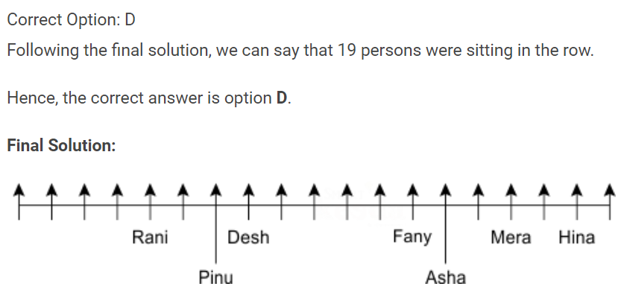
Answer – 1

Slide 4
Directions: Study the following information carefully and answer the questions given beside:
Some persons are sitting in a row facing north. Hina sits second to right of Mera. Desh sits fifth to left of Fany. Pinu is second to right of Rani. Hina and Asha have three persons between them. Desh and Rani have two persons between them. No one sits between Asha and Fany. Number of persons towards right of Asha is one less than the number of persons sitting between Pinu and Asha. Number of persons towards left of Rani is equal to the number of persons sitting between Fany and Hina.
2. How many persons were sitting between Pinu and Asha?
A. Three B. Five
C. Seven D. Six

Slide 5
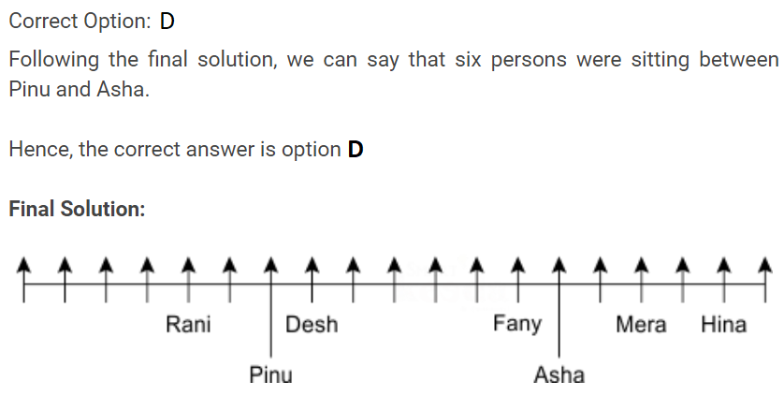
Answer – 2

Slide 6
Directions: Study the following information carefully and answer the questions given beside:
Some persons are sitting in a row facing north. Hina sits second to right of Mera. Desh sits fifth to left of Fany. Pinu is second to right of Rani. Hina and Asha have three persons between them. Desh and Rani have two persons between them. No one sits between Asha and Fany. Number of persons towards right of Asha is one less than the number of persons sitting between Pinu and Asha. Number of persons towards left of Rani is equal to the number of persons sitting between Fany and Hina.
3. What is the position of Fany with respect to Hina?
A. Third to the left B. Fourth to the left
C. Fifth to the left D. Sixth to the left

Slide 7
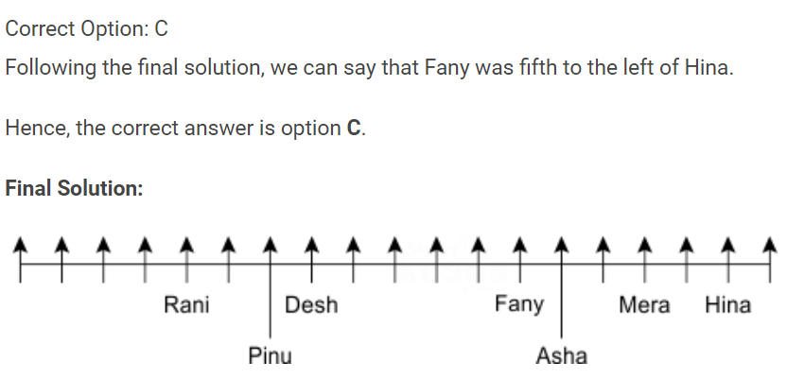
Answer – 3

Slide 8
Directions: Study the following information carefully and answer the questions given beside:
Some persons are sitting in a row facing north. Hina sits second to right of Mera. Desh sits fifth to left of Fany. Pinu is second to right of Rani. Hina and Asha have three persons between them. Desh and Rani have two persons between them. No one sits between Asha and Fany. Number of persons towards right of Asha is one less than the number of persons sitting between Pinu and Asha. Number of persons towards left of Rani is equal to the number of persons sitting between Fany and Hina.
4. What is the total number of persons that were sitting on the right of Hina and on the left of Rani?
A. 5 B. 8
C. 10 D. 11

Slide 9
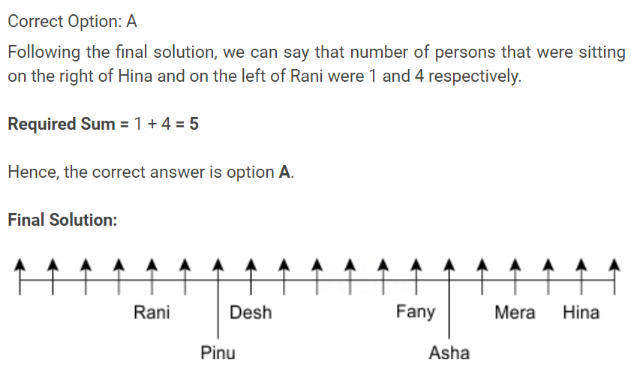
Answer – 4

Slide 10
Directions: Study the following information carefully and answer the questions given beside:
Some persons are sitting in a row facing north. Hina sits second to right of Mera. Desh sits fifth to left of Fany. Pinu is second to right of Rani. Hina and Asha have three persons between them. Desh and Rani have two persons between them. No one sits between Asha and Fany. Number of persons towards right of Asha is one less than the number of persons sitting between Pinu and Asha. Number of persons towards left of Rani is equal to the number of persons sitting between Fany and Hina.
5. If Riya is sitting in the middle of the row then how many persons were sitting between Riya and Rani?
A. 5 B. 7
C. 6 D. 4

Slide 11
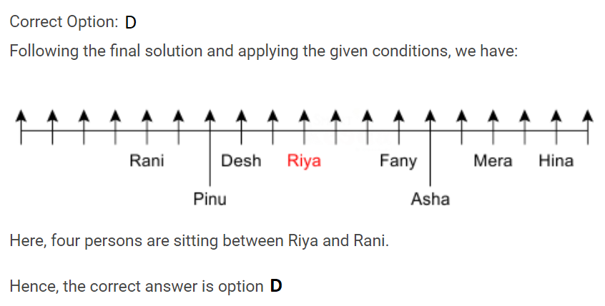
Answer – 5

Slide 12
Directions: Read the given information carefully and answer the questions given below:
A group of eight friends – Avdhesh, Baadal, Chaand, Dinesh, Eshan, Faneesh, Ganesh and Harshit are sitting in a straight line facing north. Each of them has different professions viz. Doctor, Banker, Businessman, Teacher, Lawyer, Engineer, Pilot and CA. Each of them like different colours viz. Pink, Yellow, Red, Black, Blue, Orange, White and Green, but not necessarily in the same order.
Avdhesh, who is a lawyer, sits third to the left of Faneesh. Neither Avdhesh nor Faneesh sit at the extreme ends of the line. Eshan, who likes pink color, is a businessman. Eshan is not an immediate neighbor of either Avdhesh or Faneesh. One person is sitting between Harshit and Chaand, Harshit likes orange color. Chaand, who is a pilot, likes Red colour. Ganesh, who is a doctor, sits at the extreme end of the line and likes white colour. Baadal, who is a teacher likes Green colour and sits to the immediate left of Avdhesh. Avdhesh does not like either Blue or Yellow colour. One who is a CA sits to the immediate left of the Doctor. Faneesh, who is a Banker, does not like Yellow colour.
6. Which one of the following likes Black color?
A. Dinesh B. Faneesh
C. Harshit D. Avdhesh

Slide 13
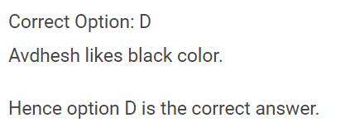
Answer – 6

Slide 14
Directions: Read the given information carefully and answer the questions given below:
A group of eight friends – Avdhesh, Baadal, Chaand, Dinesh, Eshan, Faneesh, Ganesh and Harshit are sitting in a straight line facing north. Each of them has different professions viz. Doctor, Banker, Businessman, Teacher, Lawyer, Engineer, Pilot and CA. Each of them like different colours viz. Pink, Yellow, Red, Black, Blue, Orange, White and Green, but not necessarily in the same order.
Avdhesh, who is a lawyer, sits third to the left of Faneesh. Neither Avdhesh nor Faneesh sit at the extreme ends of the line. Eshan, who likes pink color, is a businessman. Eshan is not an immediate neighbor of either Avdhesh or Faneesh. One person is sitting between Harshit and Chaand, Harshit likes orange color. Chaand, who is a pilot, likes Red colour. Ganesh, who is a doctor, sits at the extreme end of the line and likes white colour. Baadal, who is a teacher likes Green colour and sits to the immediate left of Avdhesh. Avdhesh does not like either Blue or Yellow colour. One who is a CA sits to the immediate left of the Doctor. Faneesh, who is a Banker, does not like Yellow colour.
7. Who is sitting between Chaand and Avdhesh?
A. Dinesh B. Badal
C. Harshit D. The one who likes black color

Slide 15
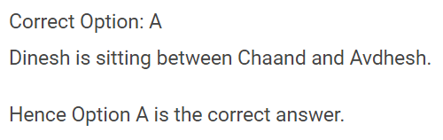
Answer – 7

Slide 16
Directions: Read the given information carefully and answer the questions given below:
A group of eight friends – Avdhesh, Baadal, Chaand, Dinesh, Eshan, Faneesh, Ganesh and Harshit are sitting in a straight line facing north. Each of them has different professions viz. Doctor, Banker, Businessman, Teacher, Lawyer, Engineer, Pilot and CA. Each of them like different colours viz. Pink, Yellow, Red, Black, Blue, Orange, White and Green, but not necessarily in the same order.
Avdhesh, who is a lawyer, sits third to the left of Faneesh. Neither Avdhesh nor Faneesh sit at the extreme ends of the line. Eshan, who likes pink color, is a businessman. Eshan is not an immediate neighbor of either Avdhesh or Faneesh. One person is sitting between Harshit and Chaand, Harshit likes orange color. Chaand, who is a pilot, likes Red colour. Ganesh, who is a doctor, sits at the extreme end of the line and likes white colour. Baadal, who is a teacher likes Green colour and sits to the immediate left of Avdhesh. Avdhesh does not like either Blue or Yellow colour. One who is a CA sits to the immediate left of the Doctor. Faneesh, who is a Banker, does not like Yellow colour.
8. Which colour is liked by the one who is a Banker?
A. Yellow B. Black
C. Blue D. None of these

Slide 17
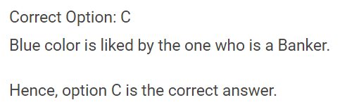
Answer – 8

Slide 18
Directions: Read the given information carefully and answer the questions given below:
A group of eight friends – Avdhesh, Baadal, Chaand, Dinesh, Eshan, Faneesh, Ganesh and Harshit are sitting in a straight line facing north. Each of them has different professions viz. Doctor, Banker, Businessman, Teacher, Lawyer, Engineer, Pilot and CA. Each of them like different colours viz. Pink, Yellow, Red, Black, Blue, Orange, White and Green, but not necessarily in the same order.
Avdhesh, who is a lawyer, sits third to the left of Faneesh. Neither Avdhesh nor Faneesh sit at the extreme ends of the line. Eshan, who likes pink color, is a businessman. Eshan is not an immediate neighbor of either Avdhesh or Faneesh. One person is sitting between Harshit and Chaand, Harshit likes orange color. Chaand, who is a pilot, likes Red colour. Ganesh, who is a doctor, sits at the extreme end of the line and likes white colour. Baadal, who is a teacher likes Green colour and sits to the immediate left of Avdhesh. Avdhesh does not like either Blue or Yellow colour. One who is a CA sits to the immediate left of the Doctor. Faneesh, who is a Banker, does not like Yellow colour.
9. Which one of the following persons is an Engineer by Profession?
A. Harshit B. The one who likes black color
C. Dinesh D. None of these

Slide 19
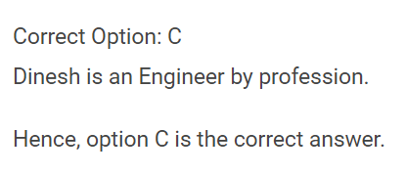
Answer – 9

Slide 20
Directions: Read the given information carefully and answer the questions given below:
A group of eight friends – Avdhesh, Baadal, Chaand, Dinesh, Eshan, Faneesh, Ganesh and Harshit are sitting in a straight line facing north. Each of them has different professions viz. Doctor, Banker, Businessman, Teacher, Lawyer, Engineer, Pilot and CA. Each of them like different colours viz. Pink, Yellow, Red, Black, Blue, Orange, White and Green, but not necessarily in the same order.
Avdhesh, who is a lawyer, sits third to the left of Faneesh. Neither Avdhesh nor Faneesh sit at the extreme ends of the line. Eshan, who likes pink color, is a businessman. Eshan is not an immediate neighbor of either Avdhesh or Faneesh. One person is sitting between Harshit and Chaand, Harshit likes orange color. Chaand, who is a pilot, likes Red colour. Ganesh, who is a doctor, sits at the extreme end of the line and likes white colour. Baadal, who is a teacher likes Green colour and sits to the immediate left of Avdhesh. Avdhesh does not like either Blue or Yellow colour. One who is a CA sits to the immediate left of the Doctor. Faneesh, who is a Banker, does not like Yellow colour.
10. Which one of the following persons is sitting third to the right of one who likes yellow color?
A. Harshit B. Faneesh
C. The one who is a teacher D. None of these

Slide 21
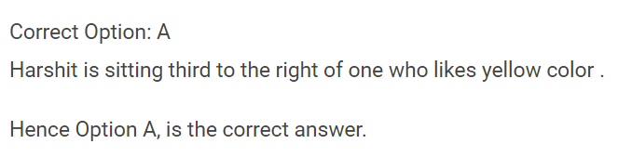
Answer – 10

Slide 22
11. If DELHI can be coded as CCIDD, how would you code BOMBAY?
AJMTVT
B. AMJXVS
C. MJXVSU
D. WXYZAX

Slide 23
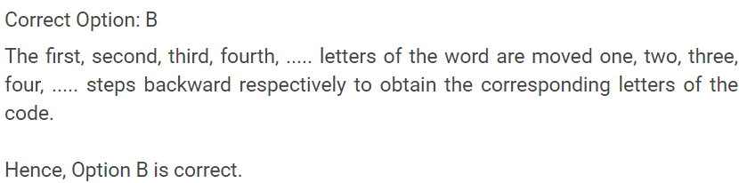
Answer – 11

Slide 24
12. In a certain code, BELIEF is written as AFKKDI. How is SELDOM written in that code?
A. RDKCNL B. RFKENM
C. RFKFNP D. TFKENP

Slide 25
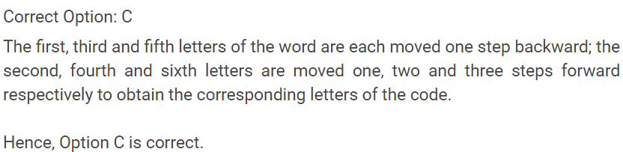
Answer – 12

Slide 26
Directions: Read the given information carefully and answer the questions given below:
In a four storey building, 10 people namely – Harsh, Raj, Eli, Rahul, Simran, Sunny, Neeraj, Viraj, Anjali and Mani live on different floors, such that one person lives in one flat only. Each floor in this building has 3 unique flats – Flat number 101, Flat number 110 and Flat number 111 respectively from left to right. The ground floor is taken as first floor and the floor on the top is taken as fourth floor. Each of the flats is designed in such a manner that flat number 101 of second floor is just above flat number 101 of first floor and likewise.
Some additional information is given below:
As per the suggestion of an astrologer, Harsh decided never to stay on an even numbered floor and in an even numbered flat.
Simran stays in the flat just above Rahul's.
Raj and Eli stay on the same floor and no one else is staying with them on that floor.
The two flats in which no person is staying are on even numbered floors and even numbered flats. The flat between Anjali's and Neeraj's is unoccupied and Anjali stays in one of the flats above Neeraj's.
Viraj stays in an odd numbered flat which is to the left of Neeraj's.
Raj and Sunny both stay in the flat which is numbered 101.
Harsh stays on the floor just above Simran’s floor and Sunny stays on one of the floors on which one flat is vacant.

Slide 27
13. In which of the following flats does Mani stay?
A. Flat number 101 of floor 3
B. Flat number 111 of floor 2
Flat number 101 of floor 2
D. Flat number 110 of floor 1

Slide 28
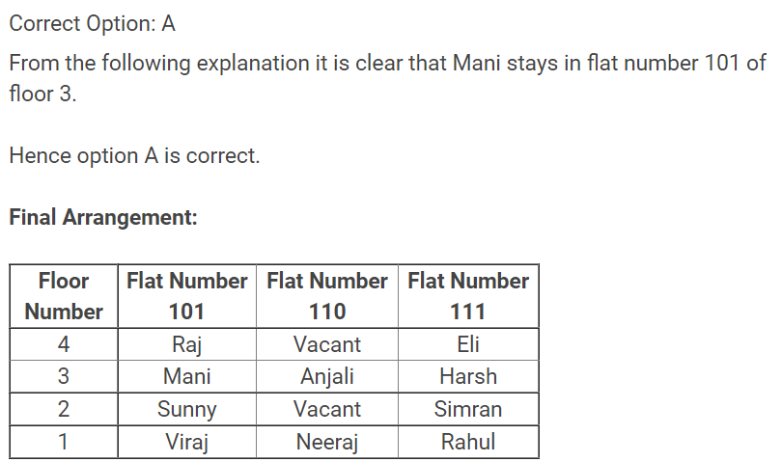
Answer – 13

Slide 29
14. Who among the following stay at floor number 3?
A. Harsh and Neeraj
B. Harsh and Mani
Sunny and Anjali
D. Sunny, Harsh and Viraj

Slide 30
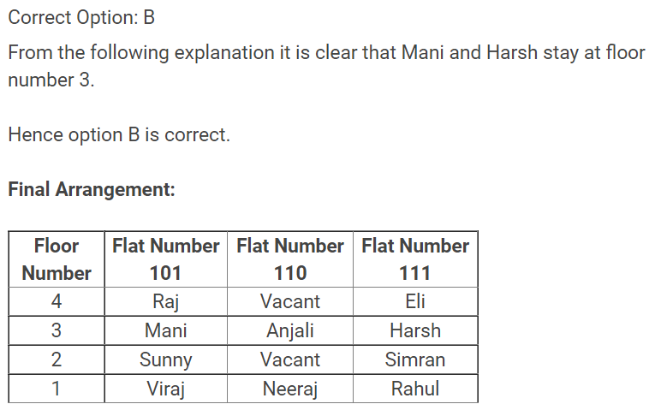
Answer – 14

Slide 31
15. Who among the following stay in flat number 110?
A. Anjali
B. Rahul
Neeraj
D. Both A and C

Slide 32
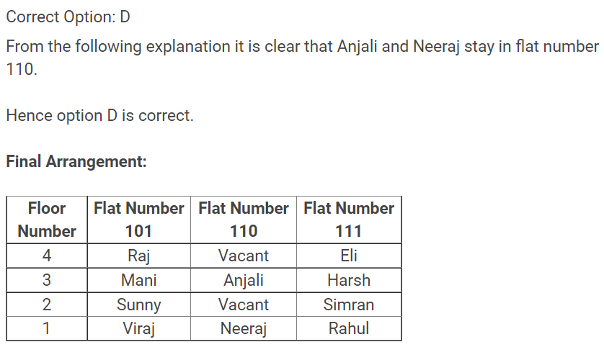
Answer – 15

Slide 33
Directions: Read the given information carefully and answer the questions given below:
There were five singers – Reema, Naina, Roma, Nisha and Priya performed in a singing concert but not necessarily in same order. They gave their performances at different timings but in back to back manner. The duration of the performance of each singer was different. The total duration of the performances by all the singers was of 10 hour. There was no gap between the performances of all the singers. The duration of the performance was for either full hour or half an hour but not for one third or one fourth hour.
Naina performed from 10:30 PM to 1 AM. Priya performed immediately before or immediately after Naina. The performance of Priya was of three hours. The duration of the performance of Nisha was more than duration of performance of Roma by 1 hour. Nisha performed just after the performance of Roma. The performance of Nisha was not at the last. Reema performed before the Naina but not immediate before. The duration of performance of Reema was of 1.5 hours. The timing of performance of Roma was after 5:00 PM.

Slide 34
16. What is the average duration of the performances being performed in between performances of Roma and Priya?
A. 3 hrs
B. 4.5 hrs
2.25 hrs
D. None of these

Slide 35
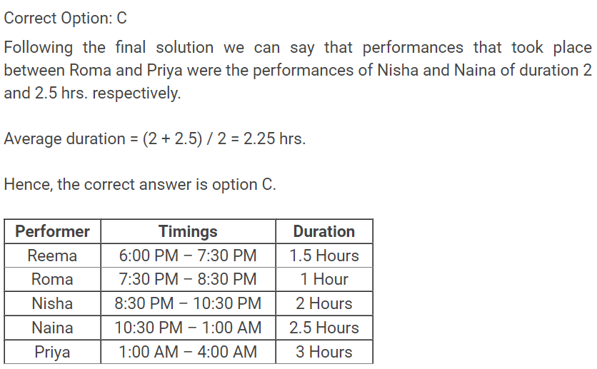
Answer – 16

Slide 36
17. Who among the following performed immediately after Naina?
A. Nisha
B. Priya
Roma
D. None of these

Slide 37
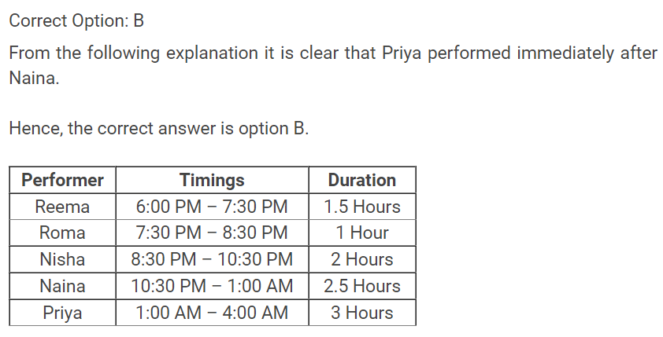
Answer – 17

Slide 38
18. How many singers started their performance after 6 PM?
A. Two
B. Three
Four
D. None

Slide 39
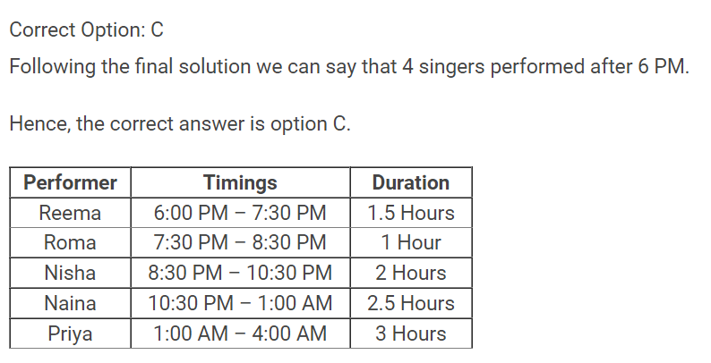
Answer – 18

Slide 40
19. Performance of Reema was longer than Roma by how much time?
A. 0.5 hour
B. 1 hour
1.5 hours
D. Either A or B

Slide 41
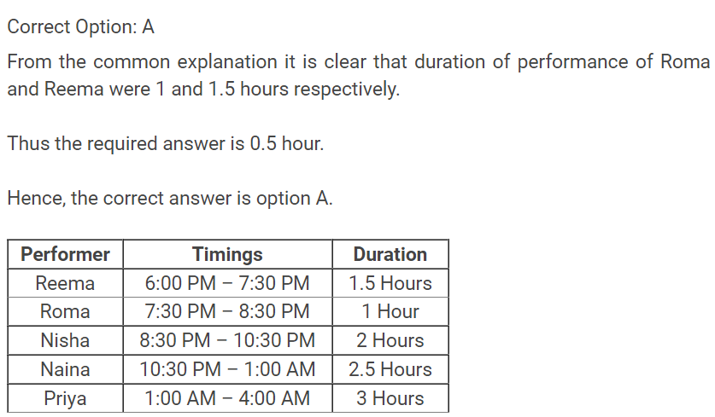
Answer – 19

Slide 42
A certain number of persons were sitting in a row facing north such that number of persons on the right of Roop was same as the number of persons on the left of Gaur. Gaur sits on the left of Roop. Deep sits exactly in the middle of Roop and Gaur, and number of persons between Deep and Roop were twice the number of persons on the right of Roop, who was 58th from the left end.
20. How many person(s) were there in the row?
A. 35 B. 55
C. 69 D. 72

Slide 43
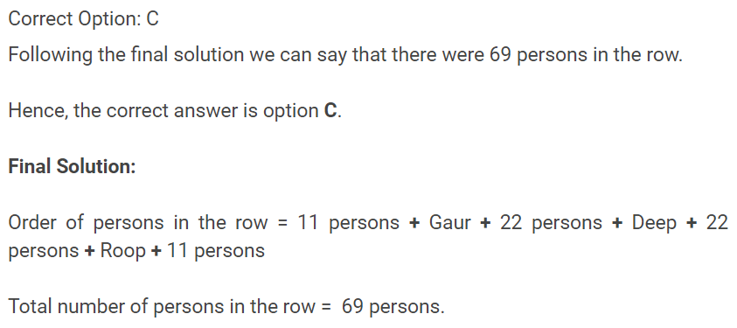
Answer – 20

